Slide 1
Unit 5 Summary
AP Macro

Slide 2
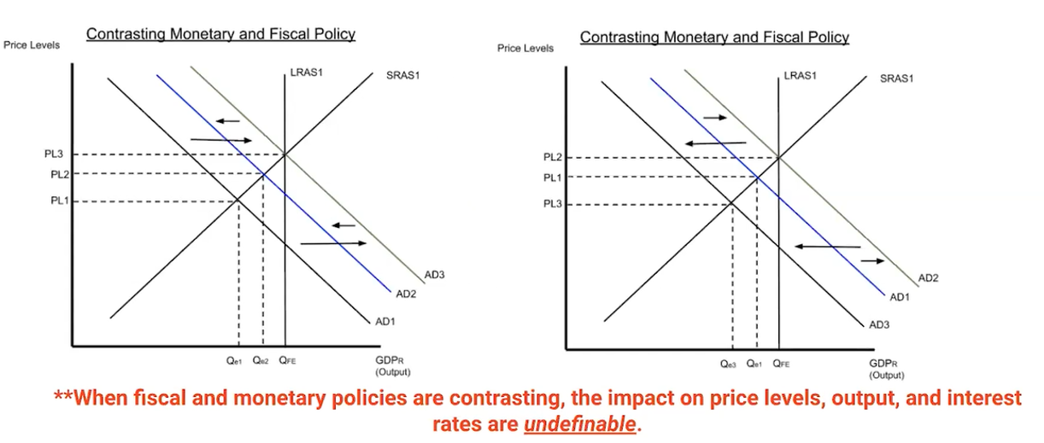
FP and MP Used Together – Opposing Direction
Summary
FP and MP can work in opposite directions, especially if the government and the Federal Reserve aren’t in agreement.
The government implements fiscal policy.
The Federal Reserve implements monetary policy.
Sometimes they may act contrary to each other.

Slide 3
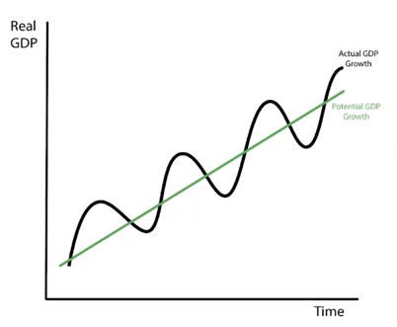
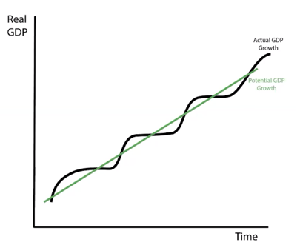
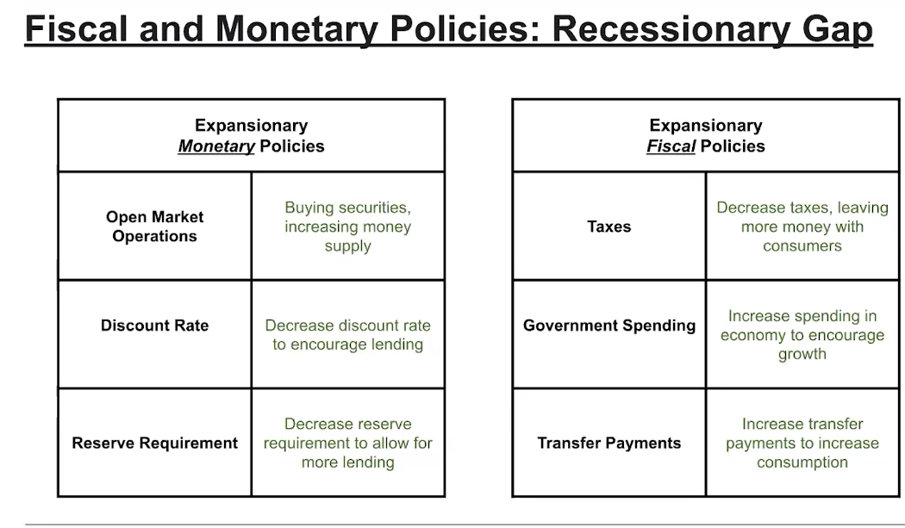
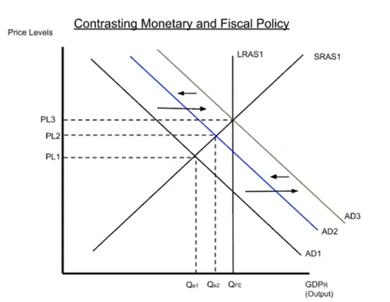
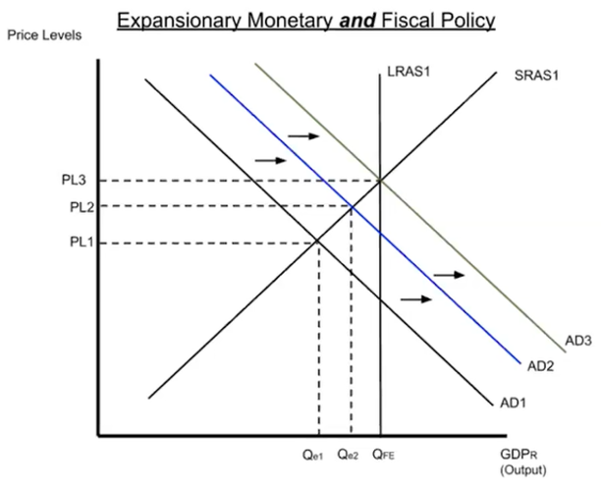
FP and MP in the Short Run Summary
FP and MP is designed to stabilize the economy, reducing the size of business cycles.
FP can work together and move in the same direction (eg. Both increase AD) OR work in opposing directions (eg. FP increases and MP decreases AD).

Slide 4
Phillips Curve

Slide 5

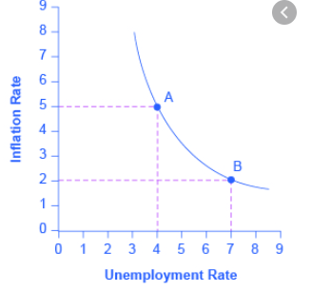
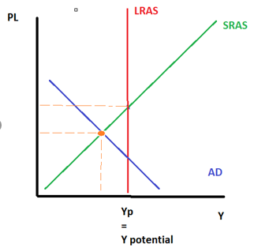
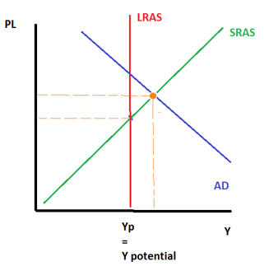
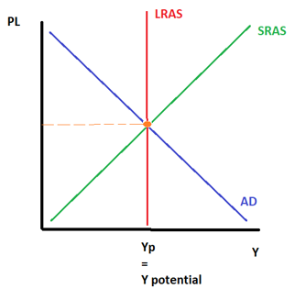
The Phillips Curve and Output Gaps
Summary
-ve output gap – ↓ Infl ↑ UR
Long Run Equilibrium – Natural Infl, NRU
+ve output gap – ↑Infl↓UR
We can see that movements of the AD curve, which cause positive or negative output gaps will move us to different points along the same Short Run Phillips Curve.
There is a negative relationship between Unemployment and Inflation!
PC
Low inflation = higher unemployment
High inflation = lower unemployment
Natural Rate of Inflation = NRU
-ve Output Gap
Full Employment / Long Run Equilibrium
+ve Output Gap

Slide 6
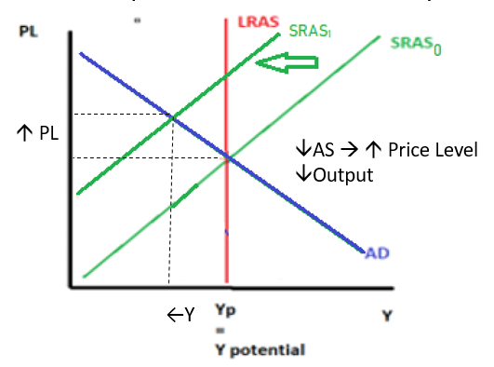
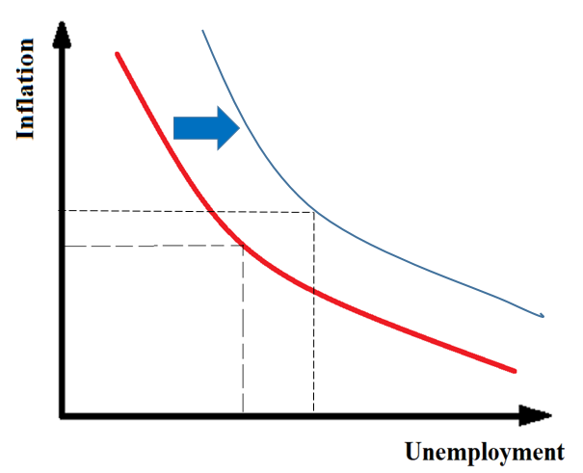
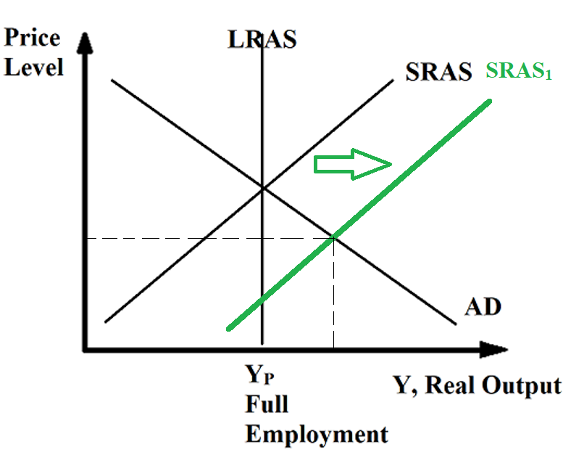
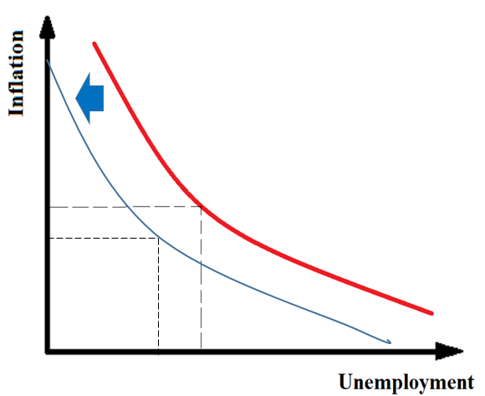
Movement of the SRPC
The movements of the SRPC are connected to the SRAS curve.
The SRPC moves as a ‘mirror image’ to the SRPC.
↓ SRAS→ ↑ Price Level, (↓Output →↓Jobs→↑Unemployment)
↑SRAS→↓Price Level, (↑Output →↑Jobs→↓Unemployment)

Slide 7
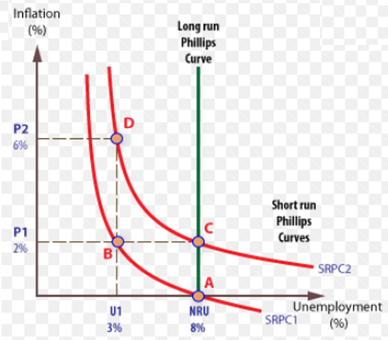
Short Run vs Long Run Phillips Curve
Summary
Short Run Phillips Curve (SRPC) – negative relationship between unemployment and inflation
Long Run Phillips Curve (LRPC) – NO relationship between unemployment and inflation
The Phillips curve shows that there is a tradeoff between inflation and the UR.
However, in the long run there is no trade off between inflation and unemployment.
This is because in the long run, price level has no effect on output because of flexible wages in the long run. Because there is no change in output, there is no change in unemployment.
Regardless of the inflation level, the unemployment will be the same.
Therefore, we distinguish between:
Short Run Phillips Curve (SRPC) – tradeoff between inflation and UR
Long Run Phillips Curve (LRPC) – NO TRADEOFF between inflation and the UR
Note that the LRPC is connected to the NRU.

Slide 8
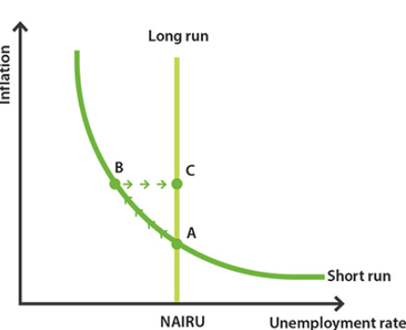
Shifts of the Phillips Curve
AD/AS Change | Effect on Phillips Curve
AD ↑AD ↓AD | Movement along SRPC Movement to the left along the SRPC Movement to the right along the SRPC
SRAS ↑SRAS ↓SRAS | Shift of SRPC SRPC shifts to the left. SRPC shifts to the right.
Change in the NRU ↑NRU ↓NRU | Shift of LRPC LRPC shifts to the right. LRPC shifts to the left. (Note: LRAS will NOT usually affect LRPC, only the NRU affects LRPC)

Slide 9
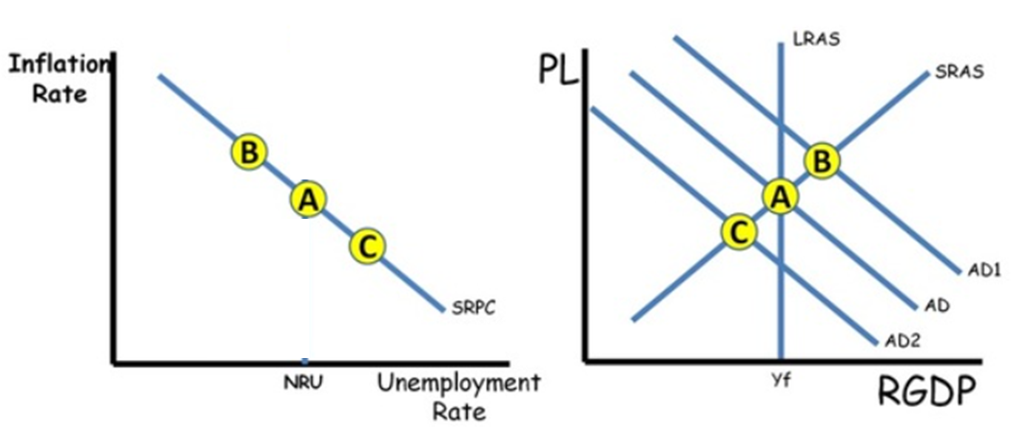
Summary
AD shifts lead to movements ALONG the SRPC
LRPC
We can see that movements of the AD curve, cause movements along the SRPC.
So we can also observe the effect of FP and MP on the SRPC
Expansionary FP/MP – movement to the left along the SRPC
Contractionary FP/MP – movement to the right along the SRPC
Note: When the AD/AS equilibrium moves right, there is a movement to the left along the SRPC.

Slide 10
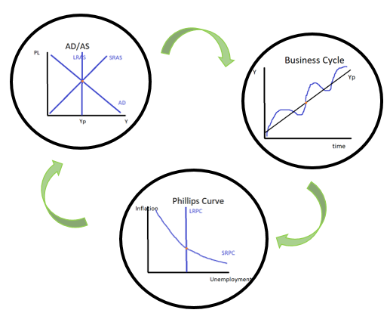
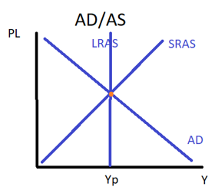
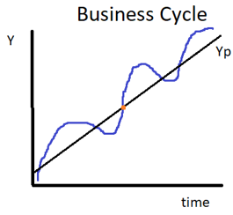
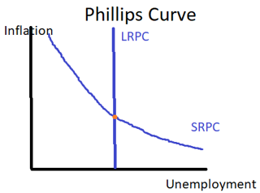
Connecting the Macro Curves
Remember that an economy can be in three situations: Positive output gap, Long run/potential output, Negative output gap
We have another graph that we can use to help represent these states; the Phillips Curve.
These situations can all be shown on the following graphs.
Business Cycle
PPC
AD/AS
Phillips Curve

Slide 11
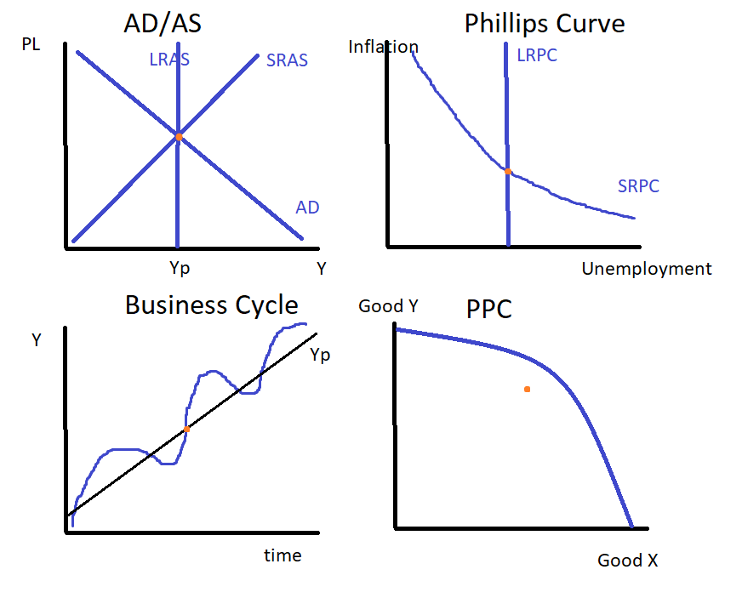
Potential Output/Long Run Equilibrium

Slide 12
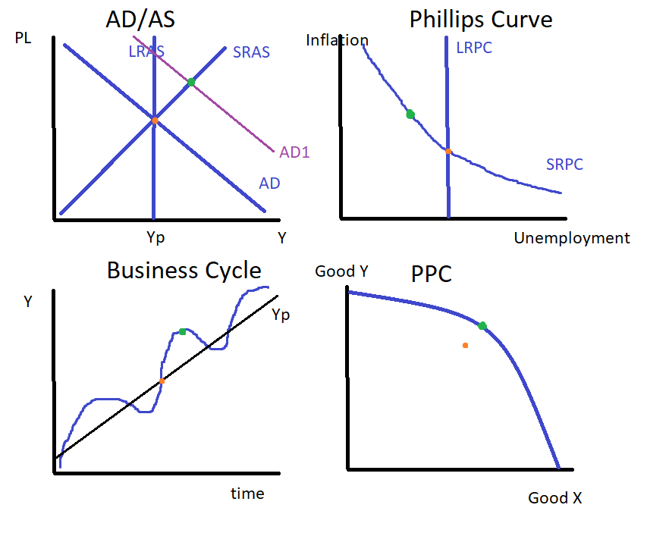

Positive Output Gap/Inflationary Gap

Slide 13
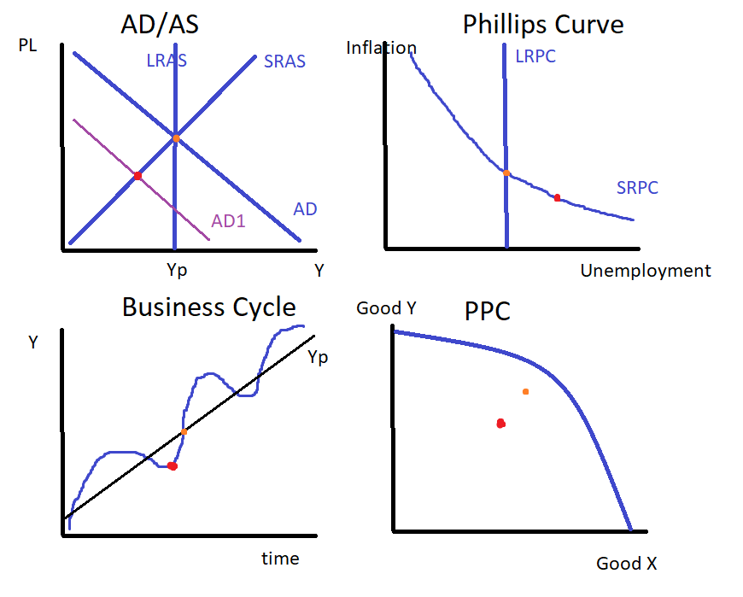

Negative Output Gap/Deflationary Gap

Slide 14
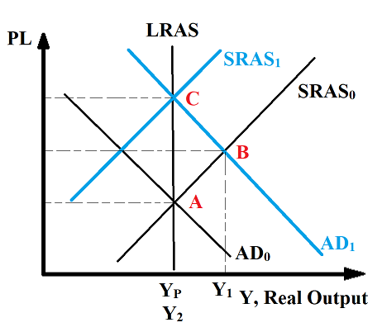
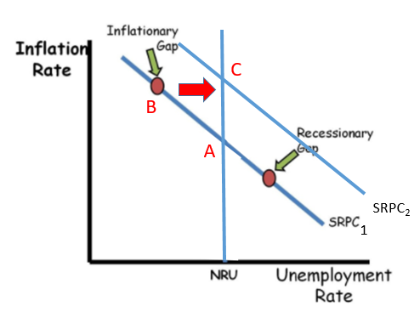
Macroeconomic Self Adjustment and the SRPC
We now know how to draw the AD/AS self adjustment process. We can now represent this on the Phillips Curve.
We now know the movements that occur to the Phillips Curves
AD shifts move along the SRPC
SRAS shifts move the SRPC
Remember that at Y_{F} you will see a return to Y_{P} which will have the NRU.
Summary
The self adjustment process can be represented on the AD/AS graph AND Phillips Curve graph.
Inflationary Gap Self Adjustment with Phillips Curve
LRPC

Slide 15
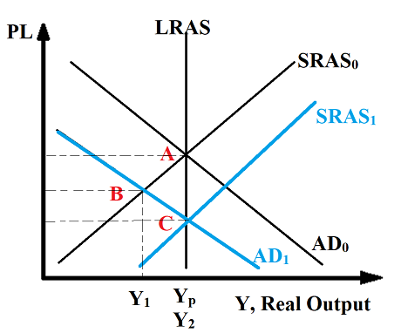
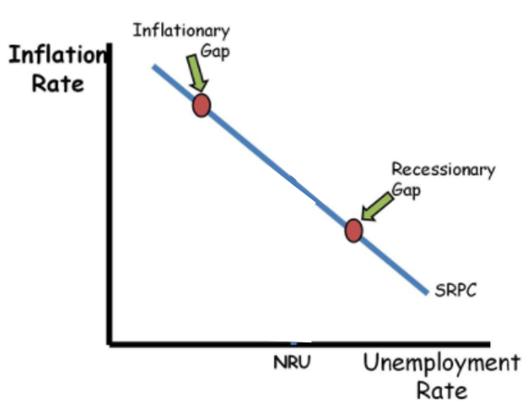
Recessionary Gap Self Adjustment with Phillips Curve
LRPC
A
B
C
SRPC₂

Slide 16
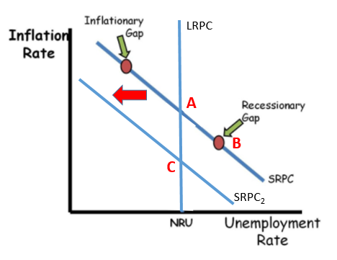
Unemployment vs Inflation
Historical Context: Paul Volcker fights high inflation in the 1980s.
What Paul Volcker taught us about taming inflation I Charts That Count – YouTube
When policymakers want to control inflation, it often comes at the cost of lower output and unemployment.
However, high and unstable inflation is also a big problem.
Policymakers sometimes have to make the hard decision of slowing the economy.
Therefore, we will see a movement along the SRPC toward lower inflation and higher unemployment.
At first the decision to fight inflation caused a contraction in the economy (A->B). However, once people began to anticipate the lower inflation level, the economy returned back to an equilibrium with a lower level of inflation.

Slide 17
Money Supply Growth and Inflation

Slide 18
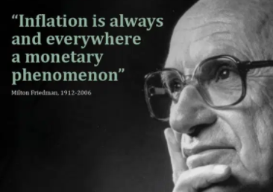


Money Supply and Inflation
Inflation occurs when the money supply increases too quickly for a sustained period.
This effect is particularly apparent in poorly managed countries such as Zimbabwe and Venezuela where government money printing (creating new money) has lead to hyperinflation.
Inflation was so bad in Zimbabwe that the US dollar was temporarily adopted as the nation’s currency because its currency became worthless.
Note: Printing money isn’t a problem, if there are more goods and services in the economy, but if more and more money chases the same number of goods, then inflation is inevitable.
(Inflation is always caused by money supply.)
Milton Friedman (above) is arguably the most influential economist of the Chicago School of Economics and is synonymous with Monetarism which focused on topics of money supply.
Among his contributions to economics is the Quantity Theory of Money.
Too much money printing
Inflation

Slide 19
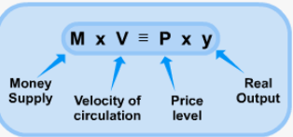
Quantity Theory of Money - Overview
Nominal GDP
The quantity theory of money is an equation that equates the movement of all money in the economy and Nominal GDP.
The amount of money in the economy
Depending on the type of money we are looking at this could mean M1 or M2 for example
Y, Real Output
How often $1 dollar changes hands in a year.
Shows the number amount of economic activity.
Price of all goods and services.
Summary
Quantity theory of money: MV = PY

Slide 20
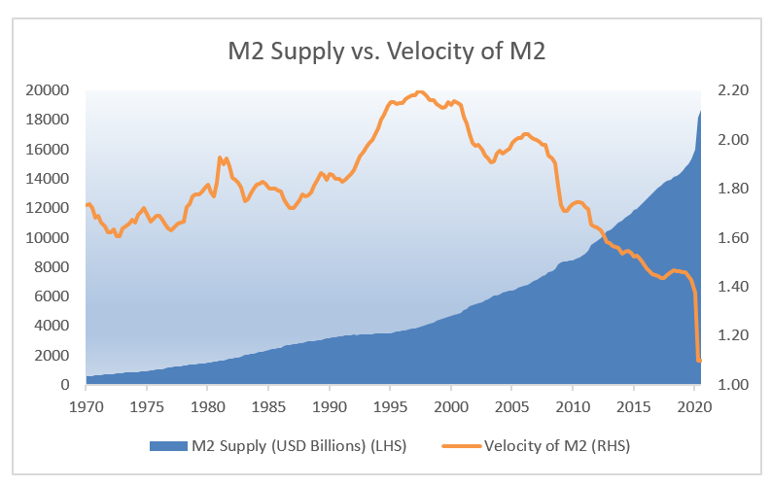
Velocity of Money
How many times a dollar is used in a transaction in a given year
Remember from our study of the spending multiplier, that spending will lead to more spending. Therefore, a dollar will change hands multiple times in a given year.
This is an indicator of the amount of economic activity that occurs in the economy.
This velocity is relatively stable but we can see that it can vary markedly over long periods of time or during large events such as Covid 19

Slide 21
Quantity Theory of Money – Values for M, V, P and Y
Stability of the values:
Stable:
Real Output is considered somewhat stable
Velocity is somewhat stable
Variable:
Money supply and price level are more variable.
Variable
Stable
Stable
Variable
Consequences of the values
The quantity theory of money assumes that Price Level and Velocity of money are relatively stable and that ↑ money supply M will inevitably lead to ↑ Price Level P.
Stated another way, this is why, when we put too much money in circulation, there will be inflation.
Summary
Quantity theory of money: MV = PY
We assume V and Y are stable, therefore ↑ Money Supply→ ↑ Price Level.

Slide 22
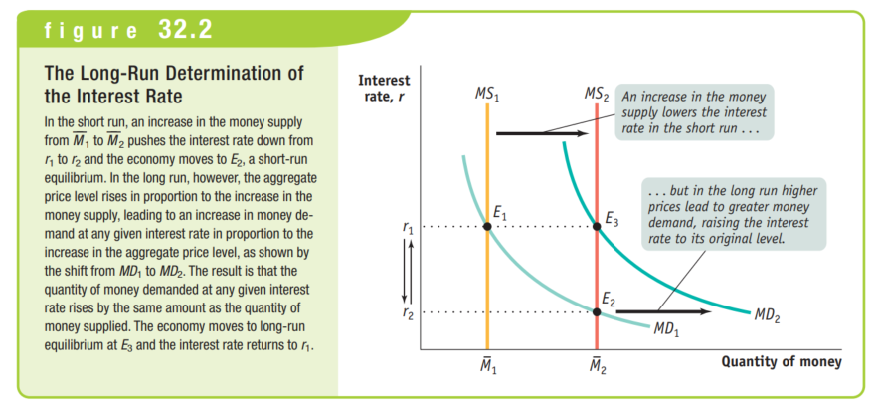
Money Supply and Inflation – Money Market
Once the money supply is increased through expansionary FP, the interest rate falls.
However, once the price level increases, MD will increase also, which will return interest rates back to the previous level.
Summary
Short Run: Expansionary MP →↓IR↑AD – MP changes output
Long Run: ↑AD→↑PL→↑MD→↑IR – MP doesn’t change output

Slide 23
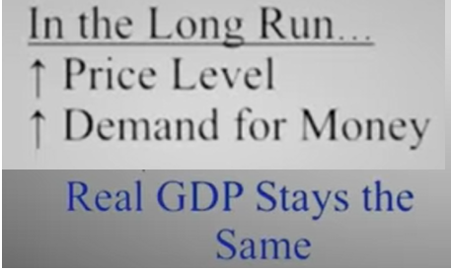
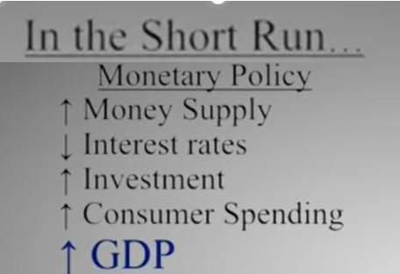
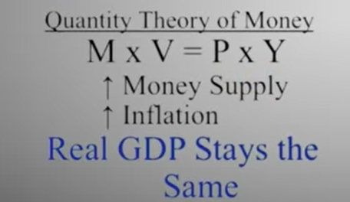
Comparing Short Run vs Long Run
Long Run
Short Run
The idea that MP has no effect in the long run seems to contradict our previous study, however we should remember that the economy behaves differently in the long run and short run.
Money Market
Money Market
Summary
Short run: MP increases GDP.
Long Run: MP has no effect on GDP.

Slide 24
Economic Growth

Slide 25
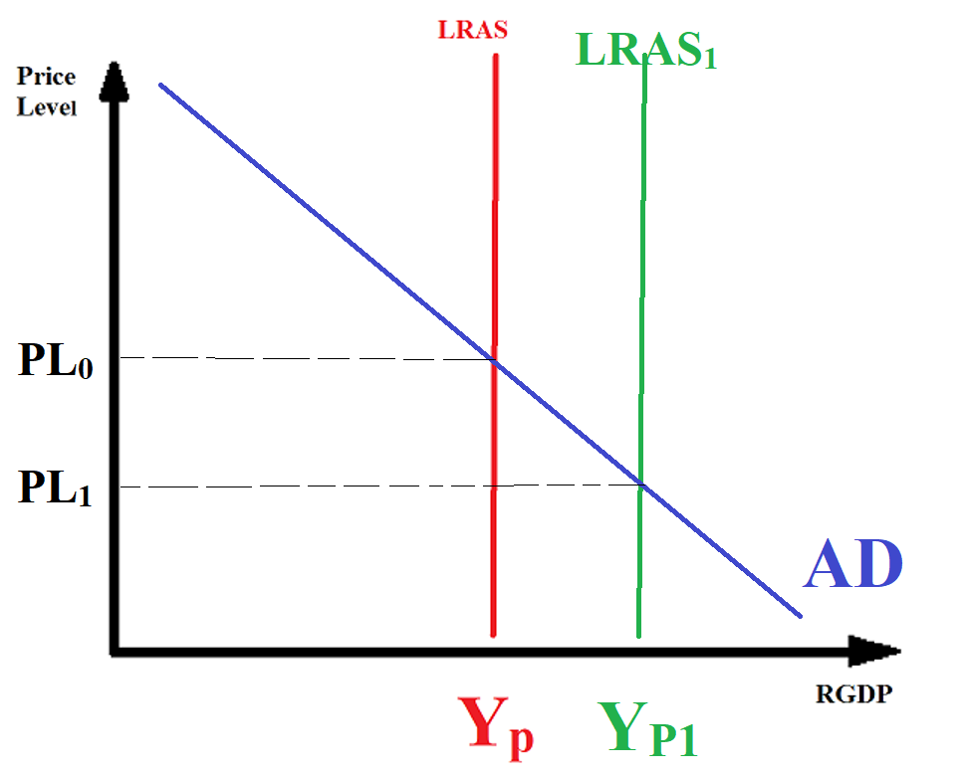
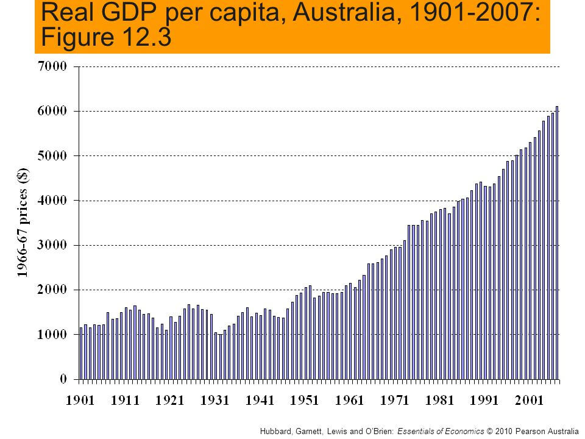

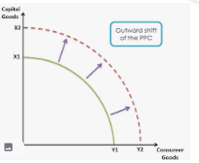



Economic Growth
Economic Growth is all about increases in real GDP per capita.
This is the result of an increase in the quantity and quality of resources and/or technology.
Simplified further, economic growth is all about one word: Productivity, more specifically, increases in productivity.
Summary
Economic growth = increase in real GDP per capita.
It is all about productivity.

Slide 26

Economic Growth, Productivity, Technology etc.
Therefore we can define the relationship between economic growth, productivity and other factors as follows:
Human Capital:
The skills and abilities of the workers.
This can be increased with education, training and experience.
Economic Growth
Determined by
Productivity increases
Capital stock formation
Technology
Human capital
Use of resources/organization (ie. Is everyone working at 100%)
Determined by
Summary
Economic growth = increase in real GDP per capita = increase in productivity

Slide 27
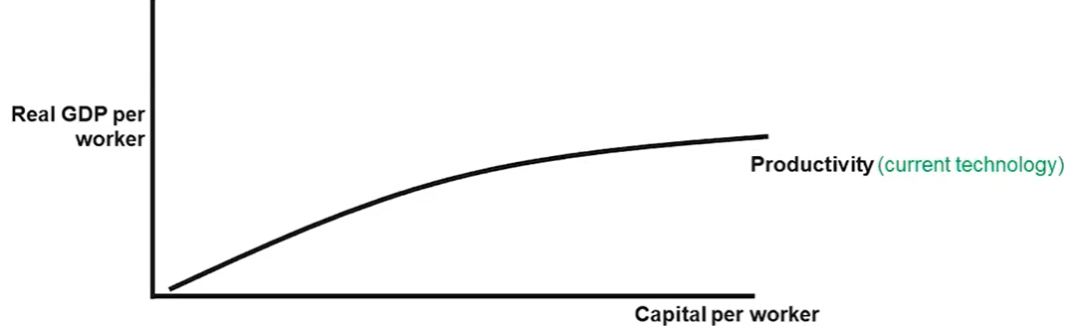
Aggregate Production Function
Diminishing Marginal Output
We can observe from the shape of the graph, diminishing marginal output as capital is added. This is because in nature we eventually reach a point of increasing scarcity.
Eg. You have a factory and add more machines which increases output. However, as the factory floor has less space, there is a loss of efficiency. In this case the scarcity is the size of the factory floor.
The aggregate production function shows that productivity or output per capita is positively related to the quantities of physical capital per worker and human capital per worker It represents production of the whole economy
We are not talking about quantity of capital because capital are not equal. Rather we are talking about the value of capital. Eg. One large machine vs 10 small machines.
More capital = more output/GDP
Therefore we see a movement along the aggregate production curve
Eg. From point A to point B
Note: More capital generally means more equipment and machinery but we can really extend it to include human capital and even natural resources. However, our focus will generally be on capital that can be increased through investment.
B
A

Slide 28

Human Capital
Human capital is all about the skills and knowledge of the worker.
A worker with more training, education and experience will have higher human capital, and therefore be able to produce more and better.

Slide 29
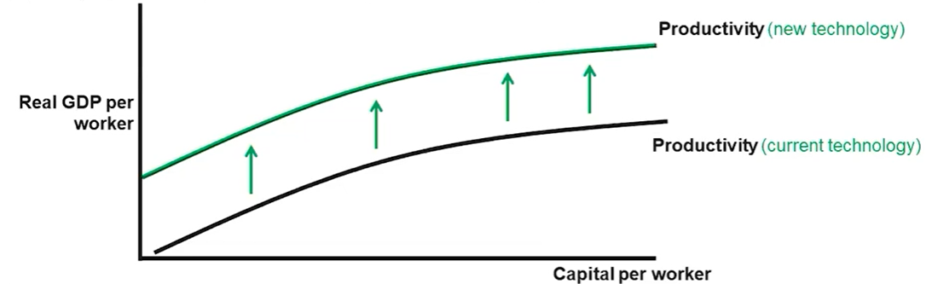
Aggregate Production Function Increases
An upward shift of the curve will occur when there is a positive change in technology
Why? Technology will improve the productivity of the capital used, which means workers can produce more.
Sea trade
Automation
Computers, phones, laptops
The internet
While we associate technology with ‘gadgets’, a broader definition would be ‘a system of collective human knowledge which allows us to better solve problems.’ (Link)

Slide 30
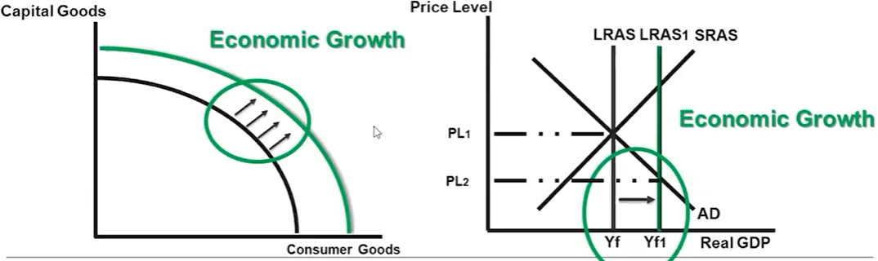
Economic Growth –AD/AS , PPC and Aggregate Production Function
Note: In the above graph we have a lower price level. This means that there is more stuff ie. Goods and services and the stuff is more affordable which is a positive thing.
Note: The main requirement for economic growth is that Real GDP per worker increases, which can be achieved through more capital or more technology.

Slide 31
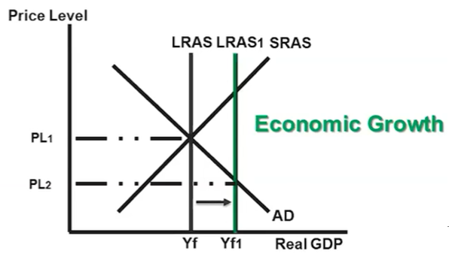
Supply Side Fiscal Policies
Summary
Supply side fiscal policies target LRAS.
Government can assist by increasing LRAS through a variety of different policies called ‘Supply Side’ Policies.
These policies can affect
productivity
labor force participation rate (LFPR) which leads to growth.
Government policies create incentives for investment in capital stock formation and technology.
The effect of these supply side fiscal policies affect the ADAS model.
Note: Most questions focus on the effect of fiscal policy on AD. Questions that concern the LRAS will usually make it clear in the wording of the question if it concerns LRAS.
Supply side policy, as the name suggests, is targeted at increasing the AS (both LRAS and SRAS) which is the key driver of economic growth.

Slide 32








Examples of Supply Side Fiscal Policies
‘Supply Side Fiscal Policies’ are all about government polices that promote economic growth by influencing both short run and long run aggregate supply. They can affect the following factors:
Human capital per worker (Education/training)
Spending on education , job training, tax credits (less tax) for education and job training
Eg. US examples: Headstart, special education, job corps, student loans, GI bills to help military veterans
Technology
Gov spending on technology or tax credits for research and development
Eg. Renewable energy, carbon emissions, SpaceX, education
Physical capital per worker (more machines)
Gov spending on infrastructure or tax credits for investment spending on physical capital
Examples: electric grid highway system
NASA is an example of government directly investing in research and development.
For a long time Tesla received a tax credit for each electric car produced.

Slide 33






Supply Side Fiscal Policies continued…
Women entering the work force was a big change that occurred in the 20th century.
Increase productivity and LFPR (labor force participation rate)
Increase age when individuals can collect retirement benefits
Increase the number of individuals to enter the labor force with tax credits
Increase spending on programs for older workers to continue working
Household economic behavior
People work harder because they are driven to earn more money that will not be taxed as much
Tax cuts – more consumption leading to more savings (spending multiplier)
More savings leads to more S_{LF} which leads to more investment and so SRAS and LRAS increase
Business behavior
Tax cuts (income tax, capital gains tax)
Businesses ‘work harder’ to achieve profits
More profit can also lead to more investment
Deregulation – also lowers the cost of doing business similar to a tax cut.
Privatization – by privatizing government organizations, private businesses will have to compete and become more efficient
High tax? I’ll just do the bare minimum.
Low tax? I get to keep all the extra money I can make. So I’ll work harder.
Regulation, often referred to as red tape can restrict businesses.

Slide 34
Incentives – Income Tax
High income tax? I’ll just do the bare minimum.
So much of human behavior can be explained through incentives.
An incentive is something that pushes people to act in a certain way.
Lower income taxes generally give individuals and businesses an incentive to work harder and make more profit.
This is because they get to keep all of the results of their hard work.
Eg. By working 30% harder you could make 30% more profit. If tax is low then you can keep more of that extra profit. If tax is high then your effort does not give you as much of a reward/payoff.
Note: We are referring to income tax and not taxes such as a consumption tax on cigarettes etc.
Low tax? I get to keep all the extra money I can make. So I’ll work harder.
Summary
Lower income taxes incentivize businesses and individuals to work harder to pursue more profit.

Slide 35
Supply side fiscal policies – What is the main idea?
‘Supply Side Fiscal Policies’ are all about government polices that promote economic growth by influencing long run aggregate supply.
Lots of individual policies about Supply Side policy
Main Ideas from these points
Human capital per worker (Education/training)
Spending on education , job training, tax credits (less tax) for education and job training
Eg. US examples: Headstart, special education, job corps, student loans, Gi bills
Technology
Gov spending on technology or tax credits for research and development
Eg. Renewable energy, carbon emissions, SpaceX, education
Physical capital per worker (more machines)
Gov spending on infrastructure or tax credits for investment spending on physical capital
Examples: electric grid highway system
Increase productivity and LFPR (labor force participation rate)
Increase age when individuals can collect retirement benefits
Increase the number of individuals to enter the labor force with tax credits
Increase spending on programs for older workers to continue working
Household economic behavior
Tax cuts – more consumption leading to more savings (spending multiplier)
More savings leads to more Slf which leads to more investment and so SRAs and LRAS increase
Business behavior
Tax cuts (income tax, capital gains tax)
This leads to more investment
Businesses work harder to achieve profits
Deregulation – also lowers the cost of doing business similar to a tax cut.
Summary:
Supply side policies increase productivity through:
Less income tax and social security
Less regulation + privatization
Spending on investment in technology, education etc.

Slide 36



Supply Side Government Policies Summary
As we saw on the previous slide, we can break down the topic of supply side policies to the following actions.
AP Exam Question Strategy: When answering AP exam questions, choose the answer that contains:
Decreasing income tax and decreasing regulation or government projects that increase resources and technology.
Less income tax and social security
We assume that the private sector is more efficient in general, and that lower tax will incentivize people to work harder and invest more, resulting in higher output
Higher Investment (businesses can use their profits)
Improved human capital (workers will expand their skills)
Higher labor force participation (people will work more)
Less regulation and more privatization
Businesses can operate freely which lowers their costs, increasing their supply.
Policies that increase the technology or resources
Increasing spending on education
Increasing spending on research and development
Increasing spending on infrastructure and physical capital
Increasing spending on training to improve labor productivity
Reducing household income taxes and business income taxes
Link to previous topics:
At the end of the day, remember that this whole section on economic growth and government policy comes down to productivity. Supply side policies can contribute to this productivity.

Slide 37
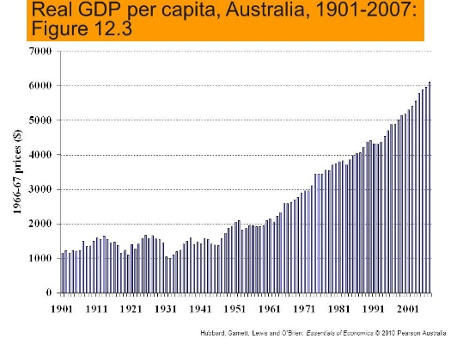


Summary: Economic Growth and Public Policy
Economic Growth
Increase in Real GDP per capita
Public Policies – Supply Side Fiscal Policy
Less tax and social security
We assume that the private sector is more efficient in general, and that lower tax will incentivize people to work harder and invest more, resulting in higher output
Higher Investment
Improved human capital
Less regulation and more privatization
Businesses can operate freely which lowers their costs, increasing their supply.
Policies that increase the technology or resources
Increasing spending on education
Increasing spending on research and development
Increasing spending on infrastructure and physical capital
Increasing spending on training to improve labor productivity
Reducing household income taxes and business income taxes
Determined by
Productivity increases
Capital stock formation
Technology
Human capital
Use of resources (ie. Is everyone working at 100%)
Determined by
Graphs to show economic growth
Effect of Investment Increases in Investment will have the biggest effect on long run growth compared to other spending because of increases to resources and technology.

Slide 38

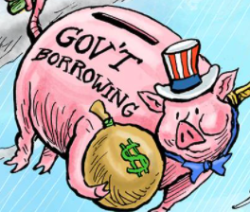


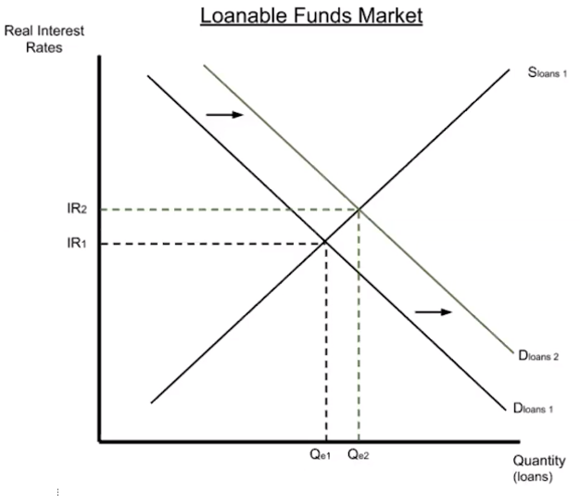
Government Budget Summary
Remember: Budget Deficit = Gov has to borrow money!
The government uses tax and/or borrowing to finance its Government spending and Government transfers.
The government budget is a plan for government expenditure and tax and can fall into three categories:
Balanced Budget: Tax = Government Expenditure
National Savings/Debt will stay the same.
Budget Deficit: Tax < Government Expenditure
National Savings will decrease/National debt will increase.
Government has to borrow money from the market for loanable funds!
Naturally connected to expansionary fiscal policy (↓Tax ↑G)
Budget Surplus: Tax > Government Expenditure
National Savings will increase/National debt will decrease.
Naturally connected to contractionary fiscal policy (↑Tax ↓G)
Budget Deficit Spending
The increase in D_{LF} as a result of the Government borrowing will increase the real interest rate.
We will see that the change in IR has consequences for the economy.

Slide 39
Government Budget Deficits/Surpluses and Fiscal Policy
Summary
Budget Deficit – tends to go with Expansionary Fiscal Policy
Budget Surplus – tends to go with Contractionary Fiscal Policy
We established in Unit 3 that Fiscal Policy is the combination of Taxes, Government spending and Government transfers to increase/decrease AD.
These are linked to the Government Budget which we said was determined by government expenditure and tax.
Associated with:
The government budget is a plan for government expenditure and tax and can fall into three categories:
Balanced Budget: Tax = Government Expenditure
Budget Deficit: Tax < Government Expenditure
Budget Surplus: Tax > Government Expenditure
Neither Expansionary or Contractionary Fiscal Policy
Expansionary Fiscal Policy
Contractionary Fiscal Policy

Slide 40


Public Debt vs Public Savings
Public Debt = negative amount
The government has borrowed money overall over a period of time.
Public debt can also be thought of as ‘negative savings’
Public Savings = positive amount
The government has saved money overall over a period of time

Slide 41
Debt vs Deficit
What is the relationship between national debt and the budget deficit?
Budget deficit = the amount for one year
National debt = the total accumulated amount over the years
Flow
Summary
Debt = the total accumulated amount, a ‘stock’
Deficit = the amount for just the year, a ‘flow’
Stock
Analogies to explain stock vs flow
Water in a bath
Budget deficit (flow) = water draining out of a bath at 1L/min
National Savings (stock) = the total amount of water in the bathtub
A car’s speed and acceleration
Budget deficit (flow) = the change in speed of the car to 5km/h slower
National Savings (stock) = the current speed of the car
We call the accumulated amount a ‘stock’ and the change in that amount a ‘flow’.

Slide 42
Surplus vs Savings
What is the relationship between national debt and the budget deficit?
Budget Surplus = the amount for one year
National Savings = the total accumulated over multiple years
Flow
Summary
Savings = the total accumulated amount
Surplus = the amount for just the year
Stock
We call the accumulated amount a ‘stock’ and the change in that amount a ‘flow’.

Slide 43
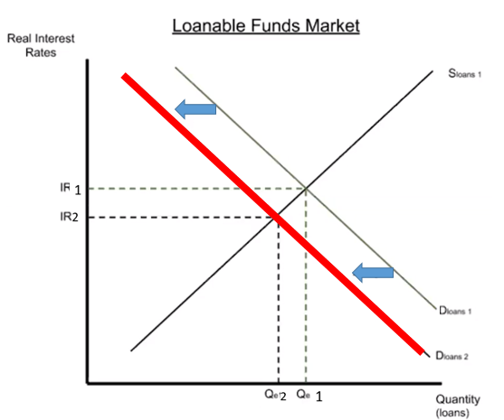
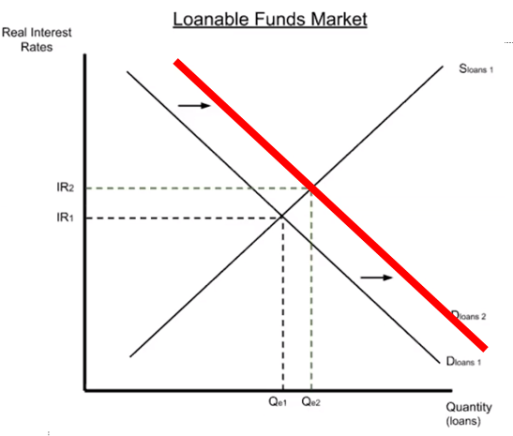
 | +/- | Definition | Effect on Public Savings (and National Savings) | Effect on Public Debt (National Debt) | Effect on Loanable Funds Market | Association to Fiscal Policy
Balanced Budget |  | Tax = Government Expenditure | No Effect | No Effect | No Effect | No connection
Budget Deficit | - | Tax < Government Expenditure | Decrease (Savings reduced) | Increase (Debt increased) | Increase D_{LF} (Gov borrowing) | Associated with Expansionary FP
Budget Surplus | + | Tax > Government Expenditure | Increase (Savings increased) | Decrease (Debt decreased) | Decrease D_{LF} (less Gov borrowing) | Associated with Contractionary FP

Slide 44
5.5 Crowding Out
We have talked about Fiscal Policy in previous classes.
There is one ‘issue’ with Fiscal Policy that we did not previously covered, which we can now analyse following our coverage of the loanable funds market.

Slide 45
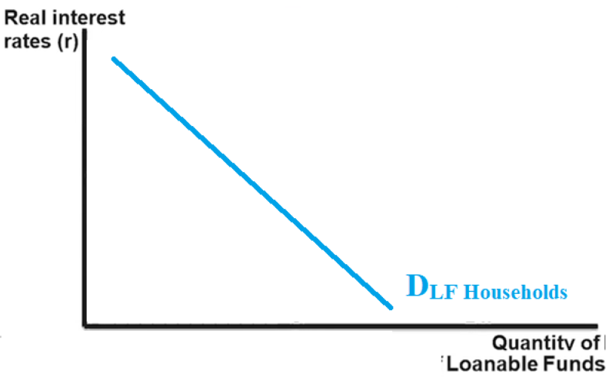
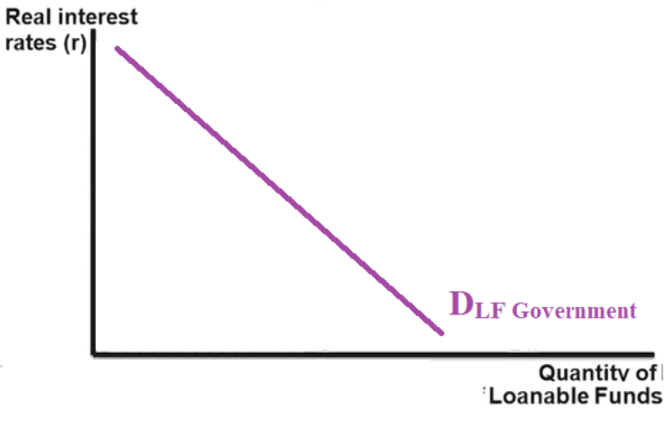


Loanable Funds Market Demand
While we have focused on the borrowing of households and firms, Government also often borrows money.
Recall that D_{LF} comes from borrowing from:
Households
Firms
Government
So if we divided the D_{LF} into D_{LF} _{Private} and D_{LF} _{Government} it would appear like this:

Slide 46
Crowding Out – Loanable Funds Market
Because the D_{LF} has increased, there is an increase in total borrowing. ↑Total borrowing
The difference between D_{LF}1 and D_{LF}2 is due to government. ↑Gov borrowing
However, because of the increase in real interest rate, private borrowing/investment will actually decrease slightly↓
This reduction in private borrowing is what gives ‘crowding out’ its name.

Slide 47

Crowding Out – AD/AS
Short Run Effect
Crowding out leads to less private investment spending
Decrease in levels of interest sensitive private spending
While G will increase, there will be a reduction in I which will counteract the increase in AD.
This will cause AD₂ rather than AD₁

Slide 48

Long Term Effect of Crowding Out
Note: This does not mean growth will be negative, just increasing at a decreasing rate.
Long Term Effects
The increase in deficit spending leads to an increase in the Real Interest Rate, which leads to a decrease in investment spending
A decrease in investment causes the economic growth rate to slow, because fewer capital goods are being produced relative to the economy's productive capacity.
This can be represented by the LRAS not shifting to the right as much.
LRAS_{crowding out}
LRAS_{no} _{crowding}
Growth (no crowding out)
Growth after crowding out
Less capital goods will lead to lower growth rates.

Slide 49


Crowding Out Summary
The governments increase in deficit spending, due to expansionary fiscal policy, causes real interest rates to increase in the loanable funds market.
Crowding out occurs from deficit spending that increases interest rates.
The increase in real interest rates leads to less creation of capital stock (and also technology improvements from research and development) which results in less economic growth.
(Note: The growth may still be positive, but less positive)
Short Run Effect
Long Run Effect

